Slide 1
FMCSA Overview
Mark Oesterle
Wisconsin Division Administrator
February 15, 2017

Slide 2
FMCSA Overview
Safety Fitness Determination Rating Process
Drug and Alcohol Clearinghouse
Complaints received by FMCSA
- 386.12
- No CSA Basic over the thresholds
- Focused Review
- National Consumer Compliant Database

Slide 3
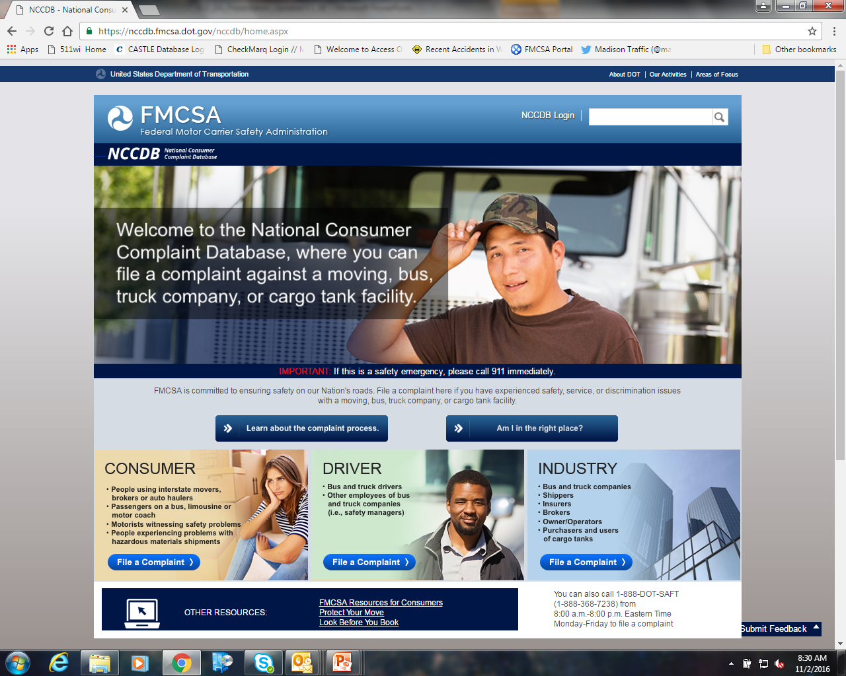
Part 382 - Types of Testing
PRE-EMPLOYMENT
RANDOM
POST-ACCIDENT
REASONABLE CAUSE
RETURN TO DUTY
FOLLOW-UP

Slide 4
Part 382 - Types of Testing
PRE-EMPLOYMENT
RANDOM
POST-ACCIDENT
REASONABLE CAUSE
RETURN TO DUTY
FOLLOW-UP

Slide 5
Electronic Logging Devices

Slide 6
What is an Electronic Logging Device (ELD)?
An ELD synchronizes with a vehicle engine to automatically record driving time, for easier, more accurate hours of service (HOS) recording
Why has FMCSA implemented a new rule about ELDs?
The rule is intended to help create a safer work environment for drivers, and make it easier and faster to accurately track, manage, and share records of duty status (RODS) data
As part of the MAP-21 Act, Congress required the adoption of the ELD rule

Slide 7
Who is required to use an ELD?
Interstate CMV drivers currently required to keep RODS
Subject to requirements in 49 CFR 395
CMVs defined in 49 CFR 390.5
≥ 10,001 pounds
Placarded hazmat
More than 8 or 15 passengers

Slide 8
Who is Exempt from the ELD Rule?
The ELD Rule applies to most motor carriers and drivers who are currently required to maintain RODS. The rule applies to commercial buses as well as trucks. Canada and Mexico domiciled drivers are included, unless they qualify for one of the exceptions to the ELD rule.
The following are not required to use ELDs (but carriers may choose to use ELDs even if they are not required):
Drivers who comply with the 100 or 150 mile radius exemption
Drivers who use paper logs no more than 8 days during any 30-day period
Driveaway-towaway operations (transporting an empty vehicle for sale, lease, or repair, provided the vehicle is part of the shipment), as defined in 49 CFR § 390.5
Drivers of vehicles manufactured before model year 2000

Slide 9
About the ELD Rule
The ELD Rule…
Specifies who is covered by the rule and the rule’s exceptions
Provides for ELDS to be certified, registered, and listed on a FMCSA website
Includes technical specifications to ensure ELDs are standardized and compliant
Has a phased implementation timeline to give carriers and drivers time to comply
Includes provisions to help prevent data tampering and harassment of drivers
Requires standard data displays and data transfer processes, making it easier to demonstrate compliance and faster to share RODS with safety officials

Slide 10
Who is Impacted by the ELD Rule?
Carriers and Drivers who are subject to the rule must install and use ELDs by the appropriate deadline
Enforcement Partners must understand enforcement and compliance procedures during each implementation phase, and which regulatory guidance applies to each
ELD Manufacturers must conform to ELD technical specifications, certify their ELDs, and register them with FMCSA

Slide 11
ELD Rule Implementation Timeline
The rule is being implemented in three phases over a four-year period:

Slide 12
ELD Rule Implementation
Phase 1 “Awareness and Transition”
February 16, 2016 to December 18, 2017
Carriers and drivers subject to the rule should prepare to comply, and may voluntarily use ELDs
Carriers and drivers subject to the rule can use any of the following for RODS status:
Paper logs
Devices with installed logging software and applications
AOBRDs (Automatic On Board Recording Devices)
ELDs that are registered and listed on the FMCSA website

Slide 13
ELD Rule Implementation
Phase 2 “Phased-In Compliance”
December 18, 2017 to December 16, 2019
Carriers and drivers subject to the rule can use:
AOBRDS that were installed prior to December 17, 2017
Certified, registered ELDs following rule publication

Slide 14
ELD Rule Implementation
Phase 3 “Full Compliance”
After December 16, 2019
All drivers and carriers subject to the rule must use certified, registered ELDs that comply with requirements of the ELD regulations

Slide 15
Logging In / Accessing an ELD
A driver must have only one driver account with a carrier, with a unique identification number and password
An owner/operator must have a single account as a driver, and a separate account for administrative functions (setting up user accounts, etc.)
What if the driver forgets to log onto the ELD?
A warning will be issued from the device to remind the driver to stop and log in
The device will also record accumulated driving time in accordance with the ELD defaults, under the unidentified driver profile
ELD events logged under the “Unidentified Driver” profile should be added to the driver’s record – or the driver should add a note (annotation) explaining that the unassigned hours are not his/hers

Slide 16
How an ELD Records Drivers’ Hours of Service
An ELD records actual time for each duty status entered or automatically started
ELDs cannot be set to record minimum duty status durations, such as 15-minute intervals
ELDs record data every hour when a vehicle is moving, and there has not been a duty status change or interim recording in the previous hour

Slide 17
ELD Duty Status Categories
“Driving”
An ELD automatically switches to driving status once the vehicle is moving at a speed of no more than five miles per hour
“On-Duty Not Driving”
When the vehicle has not been in motion for five consecutive minutes, the ELD will prompt the driver to confirm driving status or enter the proper status. If the driver doesn’t respond within one minute, the ELD will automatically switch to on-duty not driving
“Off-Duty”
The driver should indicate off-duty status or must edit and annotate the record later. Periods of authorized personal use (see Special Driving Categories, below) may also be considered off-duty time
“Sleeper Berth”
The driver should indicate sleeper berth status for sleeper berth periods or must edit and annotate the RODS later

Slide 18
Special Driving Categories to Note
“Authorized Personal Use”
A driver can record periods when using a vehicle for authorized personal use.
“Yard Moves”
A driver can record periods of yard moves
“Adverse Operations”
A driver can annotate the record to document sudden bad weather, crashes, or other unforeseeable conditions
“Oilfield Operations”
A driver can annotate the record to indicate oilfield operations

Slide 19
Engine Synchronization
Integral synchronization to the engine control module (ECM)
Monitoring of the vehicle’s engine operation to automatically capture:
Engine’s power status
Vehicle’s motion status
Miles driven
Engine hours

Slide 20
Automatically Recorded Data
Date
Time
CMV Geographic Location Information
Engine Hours
Vehicle Miles
Driver or Authenticated User Identification
Vehicle Identification
Motor Carrier Identification

Slide 21
ELD Event Data Recordings
Engine power up and shut down
Driver login/logout
Duty status changes
Personal use or yard moves
Certification of driver’s daily record
60-minute intervals when the vehicle is in motion
Malfunction of diagnostic events

Slide 22
Geolocations
CMV Geographic Location Information
Show a nearby city, town, or village, or the compass direction and distance from the nearest city, town, or village
During on-duty driving periods, the location accuracy is approximately within a 1-mile radius
When a CMV is used for personal use, the position reporting accuracy is approximately within a 10-mile radius

Slide 23
Manual Inputs
Motor carriers – User account setup
Drivers
Support personnel (mechanics, dispatch, etc.)
Drivers
Annotations, when applicable
Location description, when prompted by the ELD
CMV power unit number
Trailer number(s), if applicable
Shipping document number, if applicable

Slide 24
ELD Record of Duty Status
It is required that RODS be shared in one of two ways at roadside (choice of the driver or motor carrier):
Printout (not all ELDs provide)
Screen display visible to enforcement at a reasonable distance
Acceptance of data via fax, email or other method of transmission is at the discretion of the inspector.

Slide 25
ELD Information included in Daily Header
Unidentified Driver Records
Exempt Driver Status
Miles Today
Print/Display Date
Record Date
Shipping ID
Current Engine Hours
Current Odometer
Time Zone
Truck Tractor ID and VIN
Trailer ID
24-Hour Period Starting Time
Carrier Name/USDOT #
Driver Name and ID
Driver’s License #
Driver’s License State
Co-Driver Name and ID
Current Location
Data Diagnostic Indicators
ELD Malfunction Indicators
ELD Manufacturer Name
ELD Registration ID
**ELD Additions shown in red**

Slide 26
ELD Information – Daily Header

Slide 27
24-hour Duty Status Grid

Slide 28
ELD Detail Log Data

Slide 29
Supporting Documents: Definition
“A document, in any medium, generated or received by a motor carrier in the normal course of business as described in 395.11 that can be used, as produced or with additional identifying information, by the motor carrier and enforcement officials to verify the accuracy of a driver’s record of duty status.” [§ 395.2]

Slide 30
Supporting Documents: Data Elements
Driver name (or carrier-assigned ID)
Can be vehicle unit number if that number can be linked to the driver
Date
Location (including the name of nearest city, town or village)
Time

Slide 31
Supporting Documents: Categories
Bills of lading, itineraries, schedules, or equivalent with the origin and destination of each trip
Dispatch records, trip records, or equivalent
Expense receipts related to on-duty (not driving) periods
Electronic mobile communication records
Payroll records, settlement sheets, or equivalent

Slide 32
Supporting Documents: Number
Retain maximum of 8 documents per 24-hour duty day
If more than 8 documents are submitted per day, must retain first and last document of day
If fewer than 8 documents are submitted, a document that contains all of the elements except “time” is considered a supporting document
If a driver does not use an ELD, all toll records must be retained
Toll receipts do not count toward the 8-document cap

Slide 33
Supporting Documents: General
Must be retained for 6 months
Must be submitted within 13 days
Must be able to be matched to RODS
Cannot be destroyed, defaced, or altered
Driver must make supporting documents in his/her possession available to authorized Federal, State, or local official upon request

Slide 34
Resources
Website: www.fmcsa.dot.gov/elds
Public email address: ELD@dot.gov

Slide 35
Thank you!

